Slide 1
Programs
Computer programs, known as software, are instructions to the computer.
You tell a computer what to do through programs. Without programs, a computer is an empty machine. Computers do not understand human languages, so you need to use computer languages to communicate with them.
Programs are written using programming languages.
Liang, Introduction to Java Programming, Eleventh Edition, (c) 2018 Pearson Education, Ltd.
All rights reserved.

Slide 2
Programming Languages
Machine Language Assembly Language High-Level Language
Machine language is a set of primitive instructions built into every computer.
The instructions are in the form of binary code, so you have to enter binary codes for various instructions.
Program with native machine language is a tedious process.
Moreover the programs are highly difficult to read and modify.
For example, to add two numbers, you might write an instruction in binary like this:
1101101010011010
Liang, Introduction to Java Programming, Eleventh Edition, (c) 2018 Pearson Education, Ltd.
All rights reserved.

Slide 3
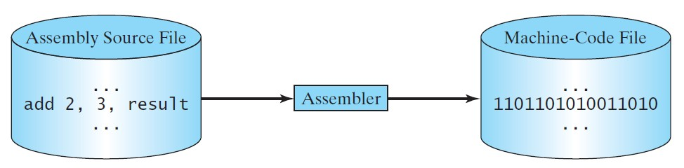
Programming Languages
Machine Language Assembly Language High-Level Language
Assembly languages were developed to make programming easy.
Since the computer cannot understand assembly language, however, a program called assembler is used to convert assembly language programs into machine code.
For example, to add two numbers, you might write an
instruction in assembly code like this:
ADDF3 R1, R2, R3
Liang, Introduction to Java Programming, Eleventh Edition, (c) 2018 Pearson Education, Ltd.
All rights reserved.

Slide 4
Programming Languages
Machine Language Assembly Language High-Level Language
The high-level languages are English-like and easy to learn and program.
For example, the following is a high-level language statement that computes the area of a circle with radius 5:
area = 5 * 5 * 3.1415;
Liang, Introduction to Java Programming, Eleventh Edition, (c) 2018 Pearson Education, Ltd.
All rights reserved.

Slide 5
Popular High-Level Languages
Language
Description
Ada
Named for Ada Lovelace, who worked on mechanical general-purpose computers. The Ada language was developed for the Department of Defense and is used mainly in defense projects.
Beginner’s All-purpose Symbolic Instruction Code. It was designed to be learned and used easily by beginners.
Developed at Bell Laboratories. C combines the power of an assembly language with the ease of use and portability of a high-level language.
C++ is an object-oriented language, based on C.
Pronounced “C Sharp.” It is a hybrid of Java and C++ and was developed by Microsoft. COmmon Business Oriented Language. Used for business applications.
FORmula TRANslation. Popular for scientific and mathematical applications.
Developed by Sun Microsystems, now part of Oracle. It is widely used for developing platform- independent Internet applications.
Named for Blaise Pascal, who pioneered calculating machines in the seventeenth century. It is a simple, structured, general-purpose language primarily for teaching programming.
A simple general-purpose scripting language good for writing short programs.
Visual Basic was developed by Microsoft and it enables the programmers to rapidly develop graphical user interfaces.
BASIC
C
C++ C#
COBOL FORTRAN
Java
Pascal
Python
Visual Basic
Liang, Introduction to Java Programming, Eleventh Edition, (c) 2018 Pearson Education, Ltd.
All rights reserved.

Slide 6
Interpreting/Compiling Source Code
A program written in a high-level language is called a source program or source code.
Because a computer cannot understand a source program, a source program must be translated into machine code for execution.
The translation can be done using another programming tool called an interpreter or a compiler.
Liang, Introduction to Java Programming, Eleventh Edition, (c) 2018 Pearson Education, Ltd.
All rights reserved.

Slide 7
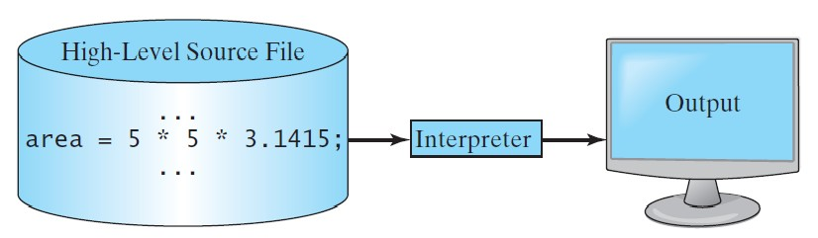
Interpreting Source Code
An interpreter reads one statement from the source code, translates it to the machine code or virtual machine code, and then executes it right away, as shown in the following figure.
Note that a statement from the source code may be translated into several machine instructions.
Liang, Introduction to Java Programming, Eleventh Edition, (c) 2018 Pearson Education, Ltd.
All rights reserved.

Slide 8
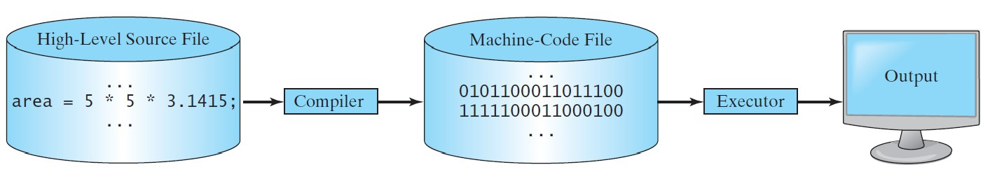
Compiling Source Code
A compiler translates the entire source code into a machine-code file, and the machine-code file is then executed, as shown in the following figure.
Liang, Introduction to Java Programming, Eleventh Edition, (c) 2018 Pearson Education, Ltd.
All rights reserved.

Slide 9
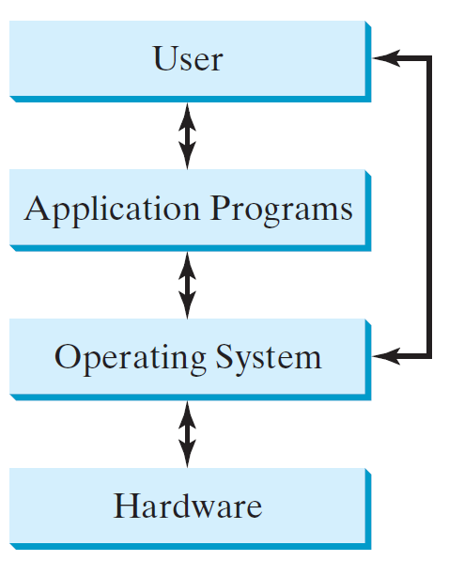
Operating Systems
The operating system (OS) is a program that manages and controls a computer’s activities.
The popular operating systems for general-purpose computers are Microsoft Windows, Mac OS, and Linux.
Application programs, such as a Web browser or a word processor, cannot run unless an operating system is installed and running on the computer.
Liang, Introduction to Java Programming, Eleventh Edition, (c) 2018 Pearson Education, Ltd.
All rights reserved.

Slide 10
Why Java?
The answer is that Java enables users to develop and deploy applications on the Internet for servers, desktop computers, and small hand-held devices.
The future of computing is being profoundly influenced by the Internet, and Java promises to remain a big part of that future.
Java is a general purpose programming language.
Java is the Internet programming language.
Liang, Introduction to Java Programming, Eleventh Edition, (c) 2018 Pearson Education, Ltd.
All rights reserved.

Slide 11
Java, Web, and Beyond
Java can be used to develop standalone applications.
Java can be used to develop applications running from a browser.
Java can also be used to develop applications for hand-held devices.
Java can be used to develop applications for Web servers.
Liang, Introduction to Java Programming, Eleventh Edition, (c) 2018 Pearson Education, Ltd.
All rights reserved.

Slide 12
Java’s History
James Gosling and Sun Microsystems
Java, May 20, 1995, Sun World
HotJava
– The first Java-enabled Web browser
Early History Website:
http://www.java.com/en/javahistory/index.jsp
Liang, Introduction to Java Programming, Eleventh Edition, (c) 2018 Pearson Education, Ltd.
All rights reserved.

Slide 13
Characteristics of Java
Java Is Simple
Java Is Object-Oriented
Java Is Distributed
Java Is Interpreted
Java Is Robust
Java Is Secure
Java Is Architecture-Neutral
Java Is Portable
Java's Performance
Java Is Multithreaded
Java Is Dynamic
www.cs.armstrong.edu/liang/JavaCharacteristics.pdf
Liang, Introduction to Java Programming, Eleventh Edition, (c) 2018 Pearson Education, Ltd.
All rights reserved.

Slide 14
JDK Versions
□ JDK 1.02 (1995)
□ JDK 1.1 (1996)
□ JDK 1.2 (1998)
□ JDK 1.3 (2000)
□ JDK 1.4 (2002)
JDK 1.5 (2004) a. k. a. JDK 5 or Java 5
JDK 1.6 (2006) a. k. a. JDK 6 or Java 6
JDK 1.7 (2011) a. k. a. JDK 7 or Java 7
JDK 1.8 (2014) a. k. a. JDK 8 or Java 8
https://www.java.com/releases/

Slide 15
JDK Editions
Java Standard Edition (J2SE)
J2SE can be used to develop client-side standalone applications or applets.
Java Enterprise Edition (J2EE)
J2EE can be used to develop server-side applications such as Java servlets, Java ServerPages, and Java ServerFaces.
Java Micro Edition (J2ME).
J2ME can be used to develop applications for mobile devices such as cell phones.
Liang, Introduction to Java Programming, Eleventh Edition, (c) 2018 Pearson Education, Ltd.
All rights reserved.

Slide 16
Popular Java IDEs
NetBeans
Eclipse
Liang, Introduction to Java Programming, Eleventh Edition, (c) 2018 Pearson Education, Ltd.
All rights reserved.

Slide 17


A Simple Java Program
// This program prints Welcome to Java! public class Welcome {
public static void main(String[] args) { System.out.println("Welcome to Java!");
}
}
Liang, Introduction to Java Programming, Eleventh Edition, (c) 2018 Pearson Education, Ltd.
All rights reserved.

Slide 18
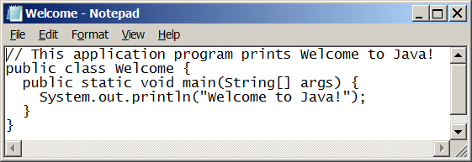
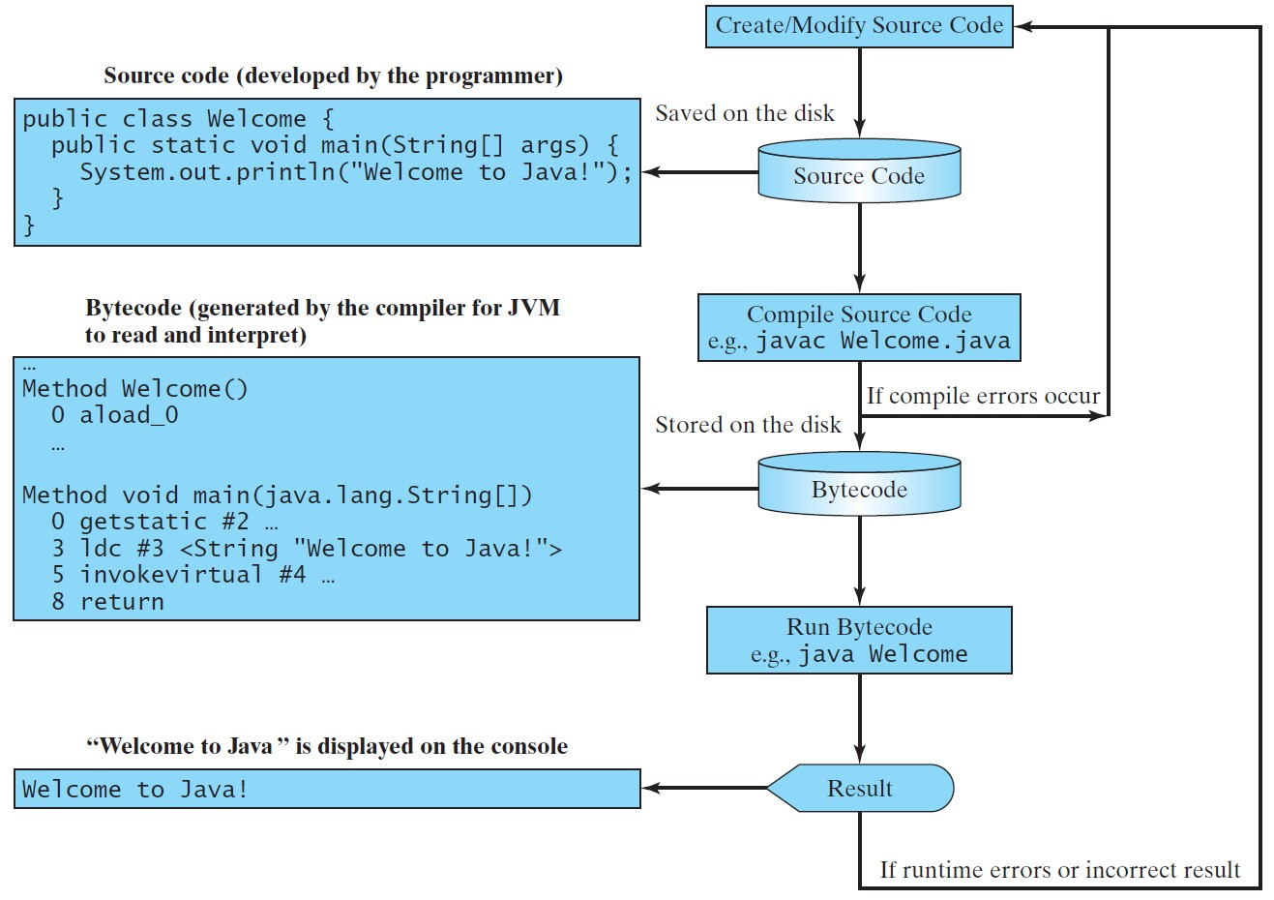
Creating, Compiling, and Running Programs
Liang, Introduction to Java Programming, Eleventh Edition, (c) 2018 Pearson Education, Ltd.
All rights reserved.

Slide 19
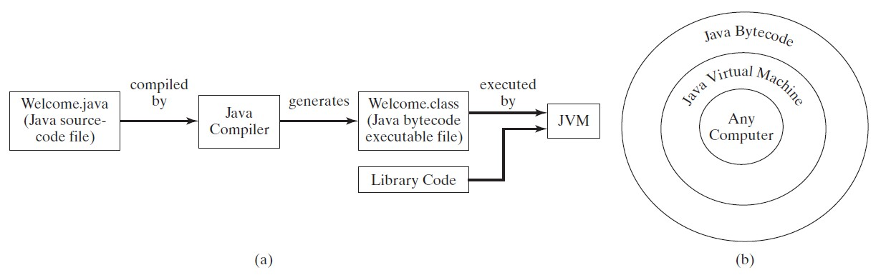
Compiling Java Source Code
Liang, Introduction to Java Programming, Eleventh Edition, (c) 2018 Pearson Education, Ltd.
All rights reserved.

Slide 20
Trace a Program Execution
Enter main method
// This program prints Welcome to Java! public class Welcome {
public static void main(String[] args) { System.out.println("Welcome to Java!");
}
}
Liang, Introduction to Java Programming, Eleventh Edition, (c) 2018 Pearson Education, Ltd.
All rights reserved.

Slide 21
Trace a Program Execution
Execute statement
// This program prints Welcome to Java! public class Welcome {
public static void main(String[] args) {
System.out.println("Welcome to Java!");
}
}
Liang, Introduction to Java Programming, Eleventh Edition, (c) 2018 Pearson Education, Ltd.
All rights reserved.

Slide 22
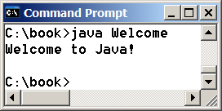
Trace a Program Execution
// This program prints Welcome to Java! public class Welcome {
public static void main(String[] args) {
System.out.println("Welcome to Java!");
}
}
print a message to the console
Liang, Introduction to Java Programming, Eleventh Edition, (c) 2018 Pearson Education, Ltd.
All rights reserved.

Slide 23
Anatomy of a Java Program
Class name
Main method
Statements
Statement terminator
Reserved words
Comments
Blocks
Liang, Introduction to Java Programming, Eleventh Edition, (c) 2018 Pearson Education, Ltd.
All rights reserved.

Slide 24
Class Name
Every Java program must have at least one class. Each class has a name. By convention, class names start with an uppercase letter. In this example, the class name is Welcome.
// This program prints Welcome to Java!
public class
Welcome
{
public static void main(String[] args) { System.out.println("Welcome to Java!");
}
}
Liang, Introduction to Java Programming, Eleventh Edition, (c) 2018 Pearson Education, Ltd.
All rights reserved.

Slide 25
Main Method
Line 2 defines the main method. In order to run a class, the class must contain a method named main. The program is executed from the main method.
// This program prints Welcome to Java! public class Welcome {
public static void main(String[] args) { System.out.println("Welcome to Java!");
}
}
Liang, Introduction to Java Programming, Eleventh Edition, (c) 2018 Pearson Education, Ltd.
All rights reserved.

Slide 26
Statement
A statement represents an action or a sequence of actions.
// This program prints Welcome to Java! public class Welcome {
public static void main(String[] args) { System.out.println("Welcome to Java!");
}
}
Liang, Introduction to Java Programming, Eleventh Edition, (c) 2018 Pearson Education, Ltd.
All rights reserved.

Slide 27
Statement Terminator
Every statement in Java ends with a semicolon (;).
// This program prints Welcome to Java! public class Welcome {
public static void main(String[] args) { System.out.println("Welcome to Java!");
}
}
Liang, Introduction to Java Programming, Eleventh Edition, (c) 2018 Pearson Education, Ltd.
All rights reserved.

Slide 28
Reserved words
Reserved words or keywords are words that have a specific meaning to the compiler and cannot be used for other purposes in the program. For example, when the compiler sees the word class, it understands that the word after class is the name for the class.
// This program prints Welcome to Java! public class Welcome {
public static void main(String[] args) { System.out.println("Welcome to Java!");
}
}
Liang, Introduction to Java Programming, Eleventh Edition, (c) 2018 Pearson Education, Ltd.
All rights reserved.

Slide 29
Blocks
A pair of braces in a program forms a block that groups components of a program.
public class Test {
public static void main(String[] args) {
Class block
System.out.println("Welcome to Java!"); Method block
}
}
Liang, Introduction to Java Programming, Eleventh Edition, (c) 2018 Pearson Education, Ltd.
All rights reserved.

Slide 30
Special Symbols
Character Name
Description
{}
Opening and closing braces
Opening and closing parentheses
Opening and closing brackets
Double slashes
Opening and closing quotation marks
Semicolon
Denotes a block to enclose statements.
()
Used with methods.
[]
Denotes an array.
//
Precedes a comment line.
" "
Enclosing a string (i.e., sequence of characters).
;
Marks the end of a statement.
Liang, Introduction to Java Programming, Eleventh Edition, (c) 2018 Pearson Education, Ltd.
All rights reserved.

Slide 31
{ … }
// This program prints Welcome to Java! public class Welcome { public static void main(String[] args) { System.out.println("Welcome to Java!");
 | }
}
Liang, Introduction to Java Programming, Eleventh Edition, (c) 2018 Pearson Education, Ltd.
All rights reserved.

Slide 32
( … )
// This program prints Welcome to Java! public class Welcome {
public static void main(String[] args) { System.out.println("Welcome to Java!");
}
}
Liang, Introduction to Java Programming, Eleventh Edition, (c) 2018 Pearson Education, Ltd.
All rights reserved.

Slide 33
;
// This program prints Welcome to Java! public class Welcome {
public static void main(String[] args) { System.out.println("Welcome to Java!");
}
}
Liang, Introduction to Java Programming, Eleventh Edition, (c) 2018 Pearson Education, Ltd.
All rights reserved.

Slide 34
// …
//
This program prints Welcome to Java!
public class Welcome {
public static void main(String[] args) { System.out.println("Welcome to Java!");
}
}
Liang, Introduction to Java Programming, Eleventh Edition, (c) 2018 Pearson Education, Ltd.
All rights reserved.

Slide 35
" … "
// This program prints Welcome to Java! public class Welcome {
public static void main(String[] args) { System.out.println("Welcome to Java!");
}
}
Liang, Introduction to Java Programming, Eleventh Edition, (c) 2018 Pearson Education, Ltd.
All rights reserved.

